Slide 1

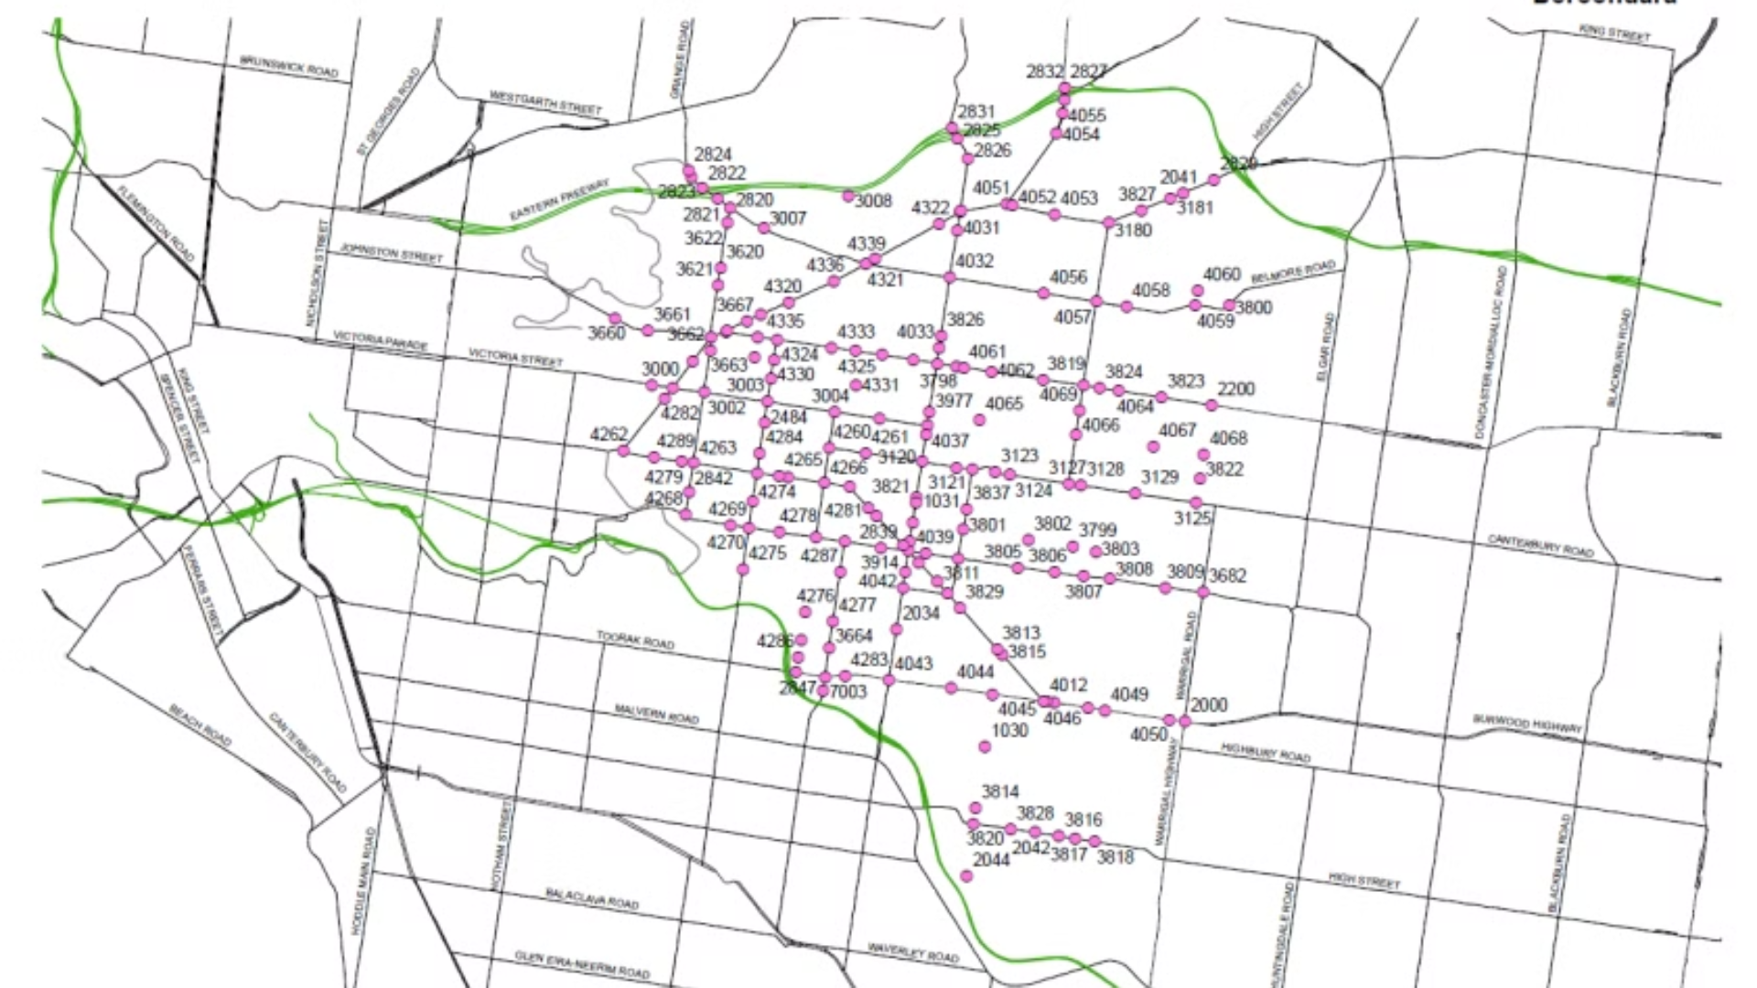

Traffic Flow Prediction System
by Team 1

Slide 2

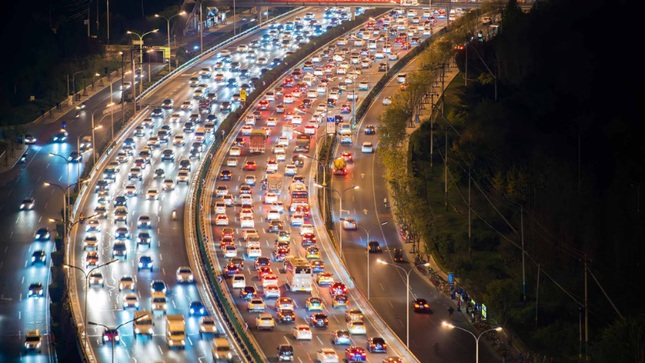
Introduction
Traffic congestion is a significant challenge in urban areas. It leads to increased travel times, fuel consumption, and pollution.
Accurate traffic flow prediction is essential for efficient traffic management and route optimization.
Traffic data exhibits complex patterns due to various influencing factors such as time of day, weather conditions, road incidents,… Traditional methods struggle to capture these complexities, necessitating advanced machine learning models.
Notes:
Traffic flow is a fundamental measurement reflecting the state of the highway. If it can be predicted accurately in advance, traffic management authorities will be able to guide vehicles more reasonably to enhance the running efficiency of the highway network. Highway traffic flow forecasting is a typical problem of spatial-temporal data forecasting. Traffic data are recorded at fixed points in time and at fixed locations distributed

Slide 3
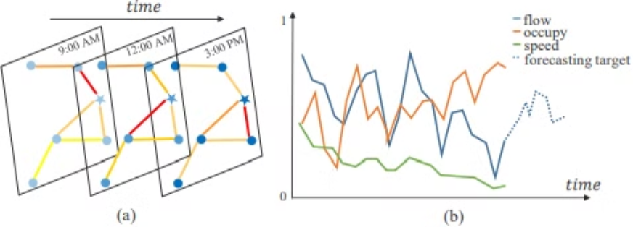
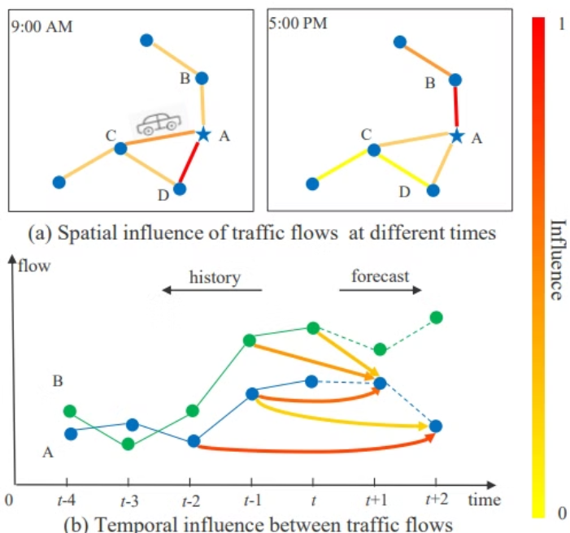
Traffic Networks
A traffic network is an undirected graph G=(N,E,A), where V is a set of N nodes, E is a set of edges, and A is the adjacency matrix. Each node detects F measurements at the same frequency, generating a feature vector of length F at each time slice.

Slide 4
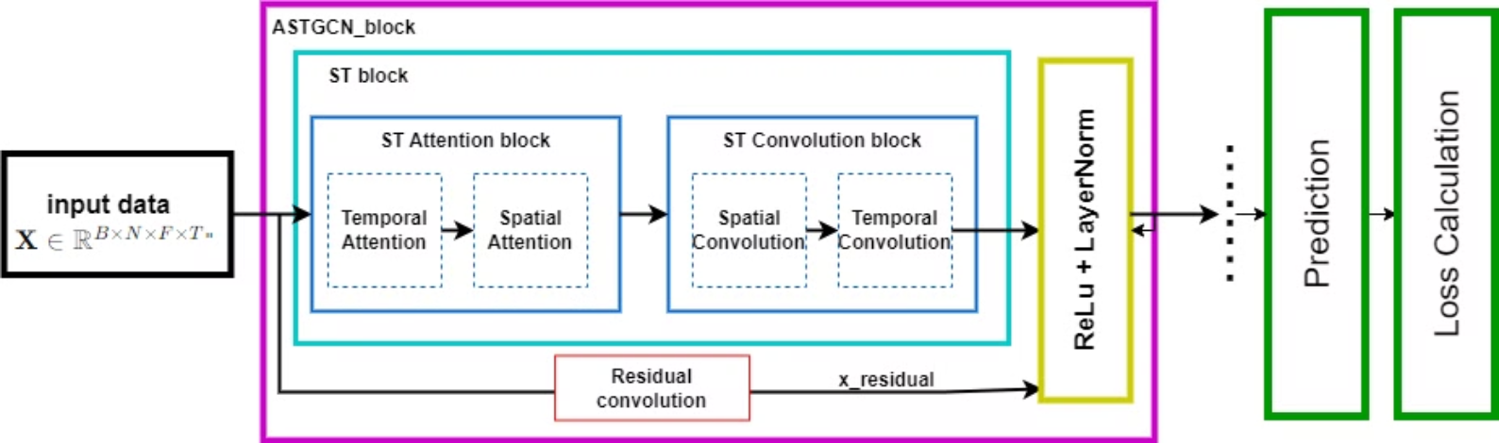
Traffic Flow Forecasting Model (ASTGCN)
2 major parts:
The spatial-temporal attention mechanism: capture the dynamic spatial-temporal correlations in traffic data
The spatial-temporal convolution: simultaneously employs graph convolutions to capture the spatial patterns and common standard convolutions to describe the temporal features
The output are convoluted and sliced to generate the final prediction results

Slide 5
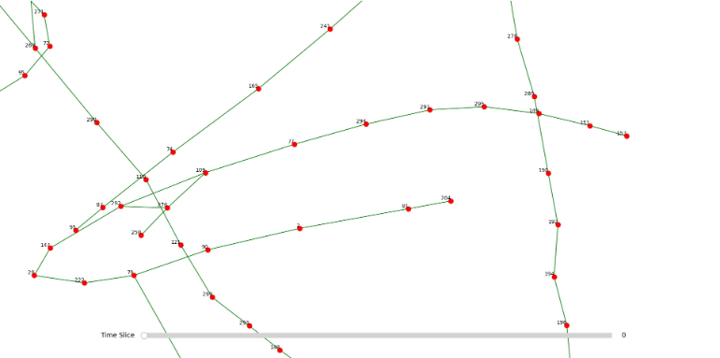
Dataset (PeMS)
2 real-world datasets from the Caltrans Performance Measurement System (PeMS)
The data was collected in real time every 30 seconds, aggregated into every 5-minute interval from the raw data.
Features: traffic flow, average speed, and average occupancy
Most recent: PeMSD4 (2018)
containing 3848 detectors on 29 roads.

Slide 6
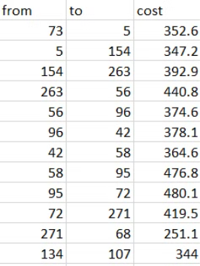
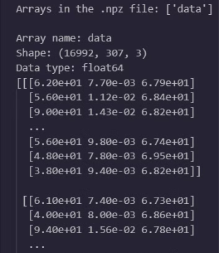
Dataset
Distance file: contains the nodes' ids and distances between traffic sensors (nodes) in the traffic network.
Pems04.npz file: contains traffic data collected from sensors over time.
Shape: (16992, 307, 3)
16992: Number of time slices/time steps.
307: Number of nodes (sensors)
3: Number of features for each node

Slide 7
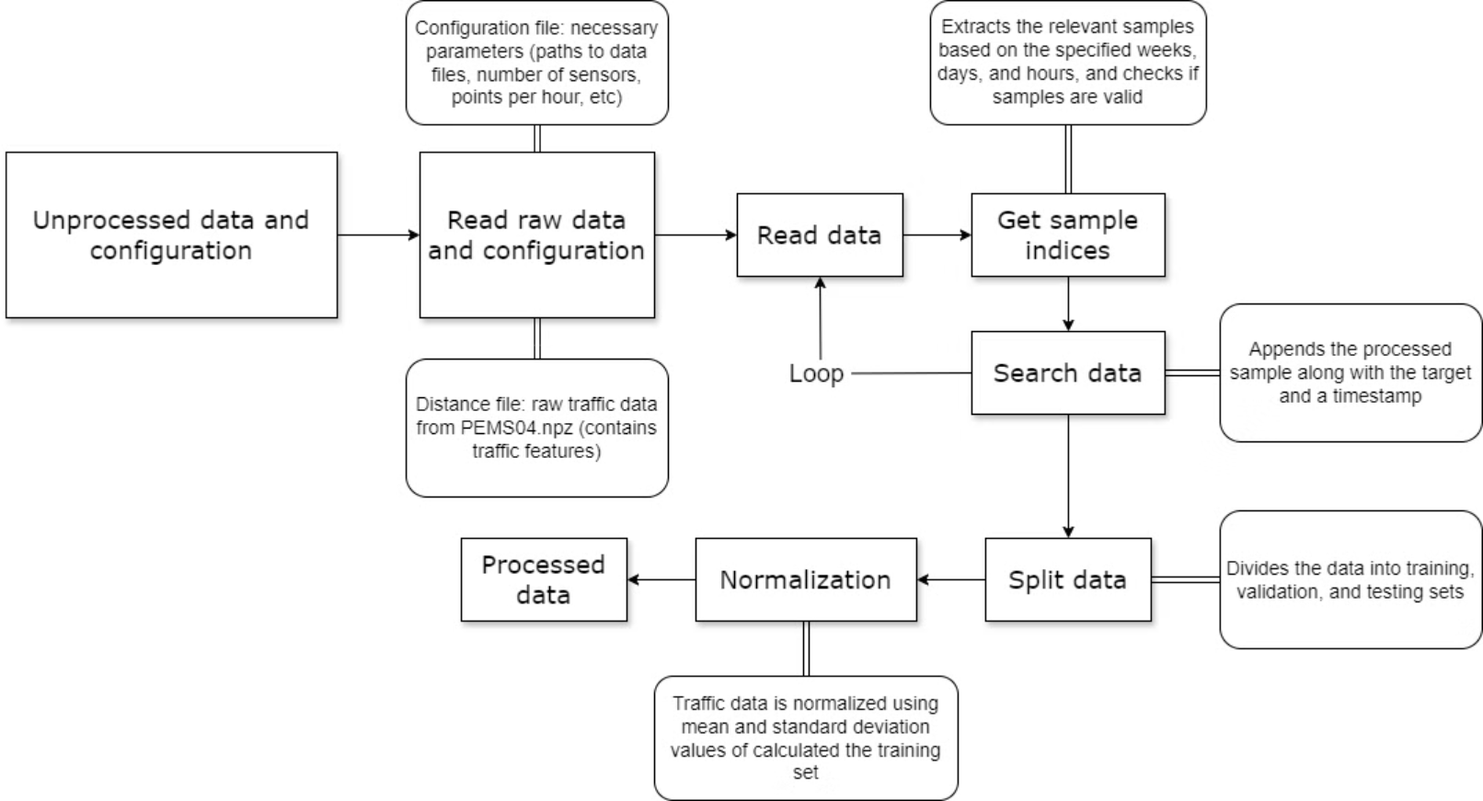
Data processing

Slide 8
Attention Mechanism
Definition and Importance
Integral to many deep learning models.
Essential for tasks involving sequential or structured data.
Functionality in Spatial-Temporal Models
Enables concentration on the most pertinent information across space and time.
Critical for capturing the complex and evolving patterns in traffic prediction.
The contribution to ASTGCN
Adaptively assign different weights to various inputs.
Owns the dynamic weighting for capturing the nature of traffic patterns.

Slide 9
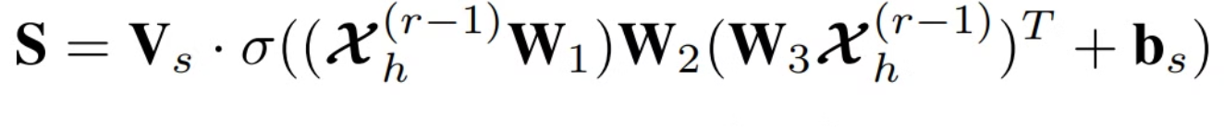
1. Spatial attention
The spatial attention mechanism in ASTGCN is designed to capture dynamic spatial dependencies within the traffic network.
The mathematical formulation of the spatial attention is:
S is the spatial attention score matrix
Vs, W1, W2 are learnable parameter matrices
bs is a learnable bias term
σ is a sigmoid activation function
x is the input feature matrix

Slide 10
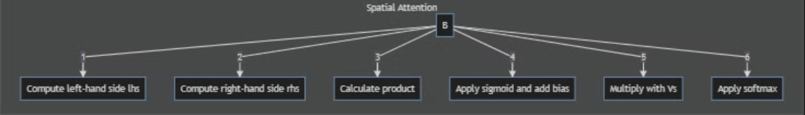
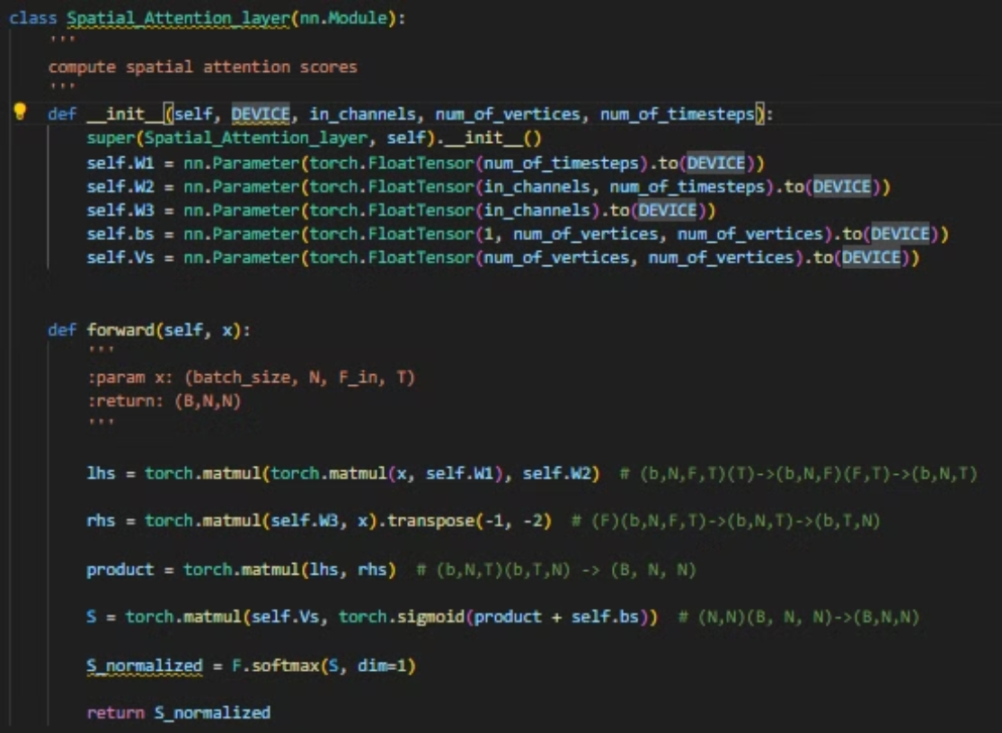
How is it implemented in code?
The process of Spatial Attention Computation (L to R):
How it is implemented in the specific class named as Spatial_Attention_layer from the ASTGCN_r.py

Slide 11
2. Temporal attention
The temporal attention mechanism focuses on capturing dynamic temporal dependencies in the traffic data.
The mathematical formulation of the temporal attention is:
E is the temporal attention score matrix
Ve, U1, U2, U3 are learnable parameter matrices
be is a learnable bias term
σ is a sigmoid activation function
X is the input feature matrix

Slide 12
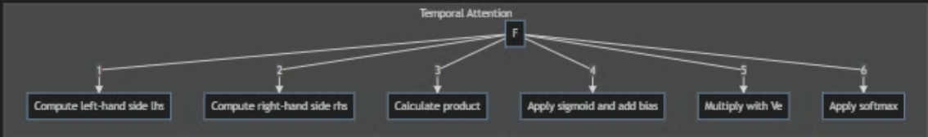
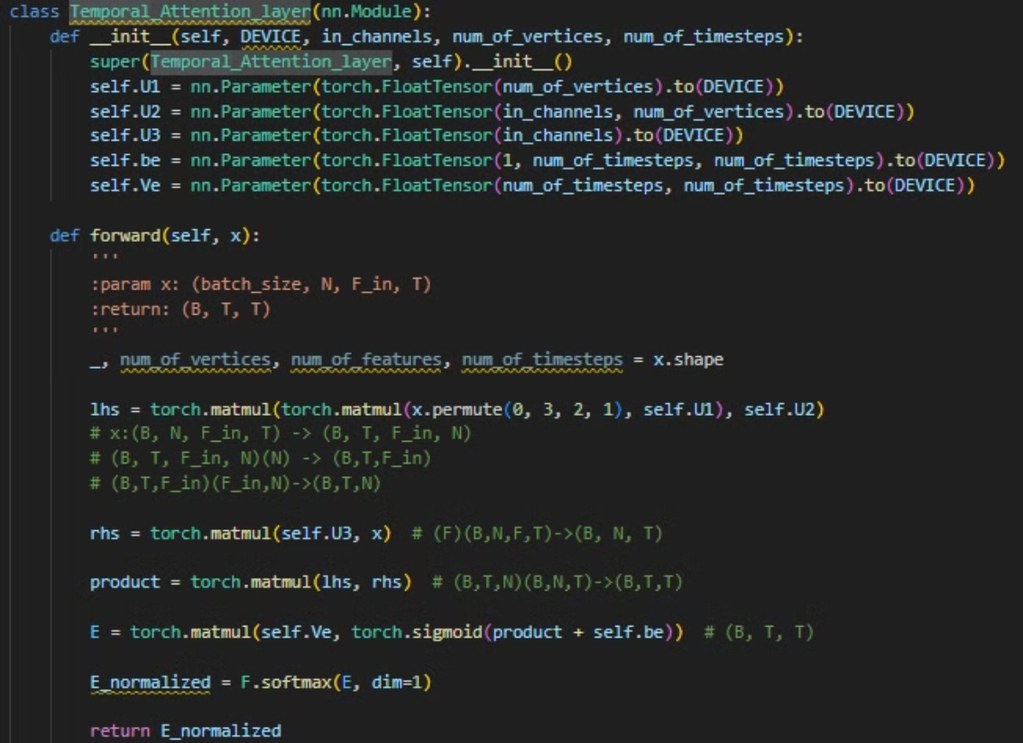
How is it implemented in code?
The process of Temporal Attention Computation (L to R):
How it is implemented in the specific class named as Temporal_Attention_layer from the ASTGCN_r.py:

Slide 13
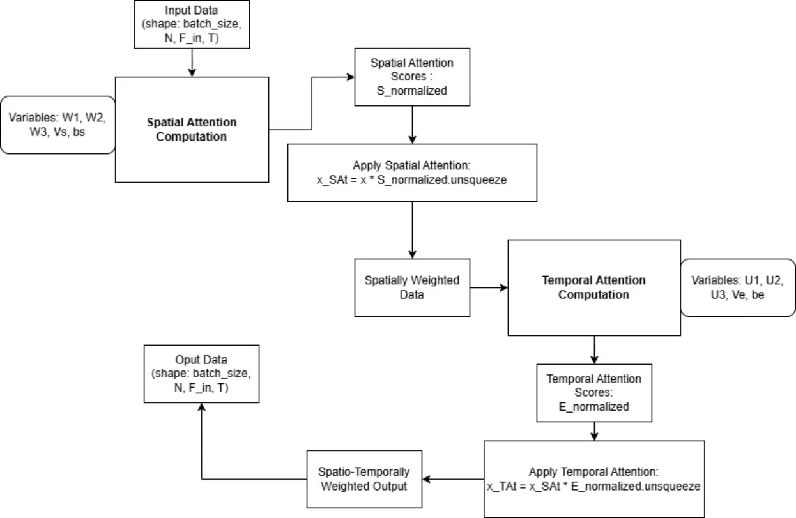
How is the process visualized in diagram?

Slide 14
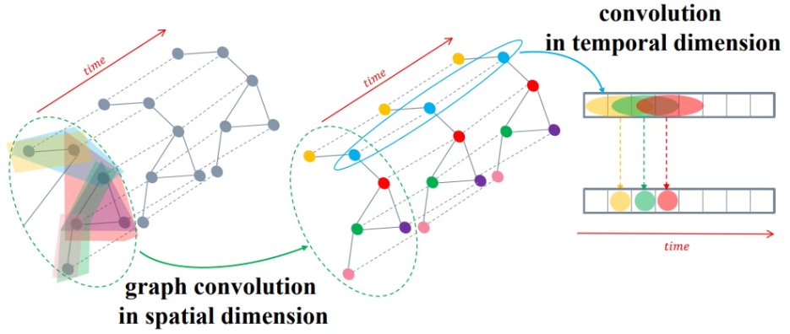
Spatial-Temporal Convolution
Traditional convolutional neural networks (CNNs):
Designed for grid-structured data (e.g., images).
Cannot be directly applied to graph-structured data (e.g., traffic networks) (Bruna et al., 2014).
Graph convolution: Address the limitation by generalizing the convolution operation to graph-structured data.
Spectral graph convolution:
Based on graph signal processing theory.
Defines the convolution operation in the spectral domain of the graph Laplacian.
The graph Laplacian is a matrix representation encoding the graph's structural properties (Hammond et al., 2011).

Slide 15
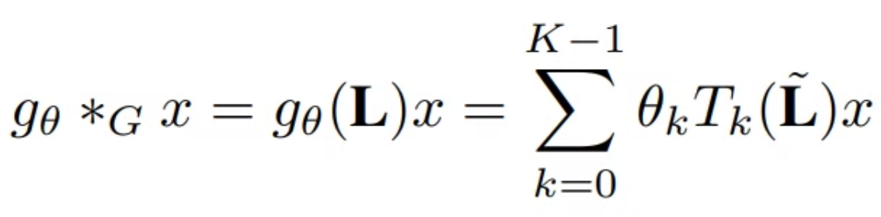
Chebyshev Graph Convolution
ASTGCN uses the Chebyshev polynomial approximation (Defferrard et al., 2016).
The mathematical formulation is:
g_θ is the filter
x is the input signal
θ_k are learnable parameters
T_k are Chebyshev polynomials
L̃ is the scaled and normalized graph Laplacian

Slide 16
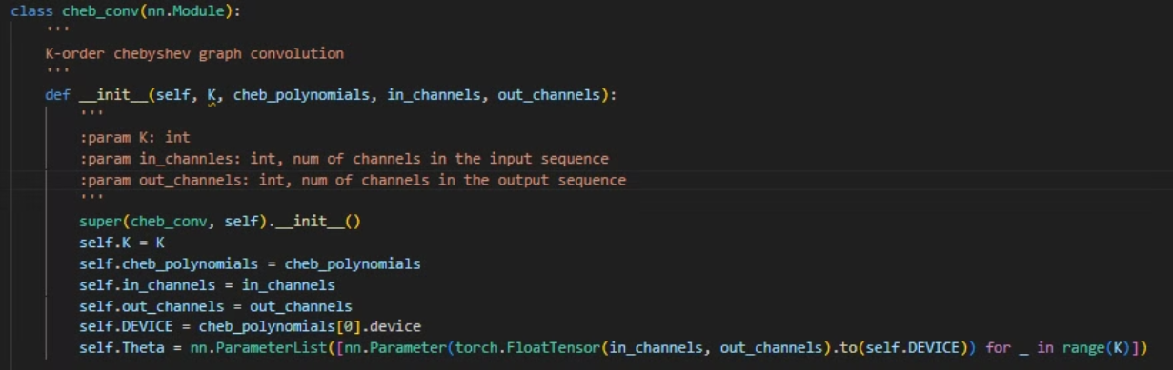
How is the Chebyshev Graph Convolution implemented in code?
Initialization
Initialization
Initialization
K: Order of Chebyshev polynomial
in_channels and out_channels: Number of input and output features
Theta: Learnable parameters for each order of the polynomial
cheb_polynomials: Pre-computed Chebyshev polynomials

Slide 17
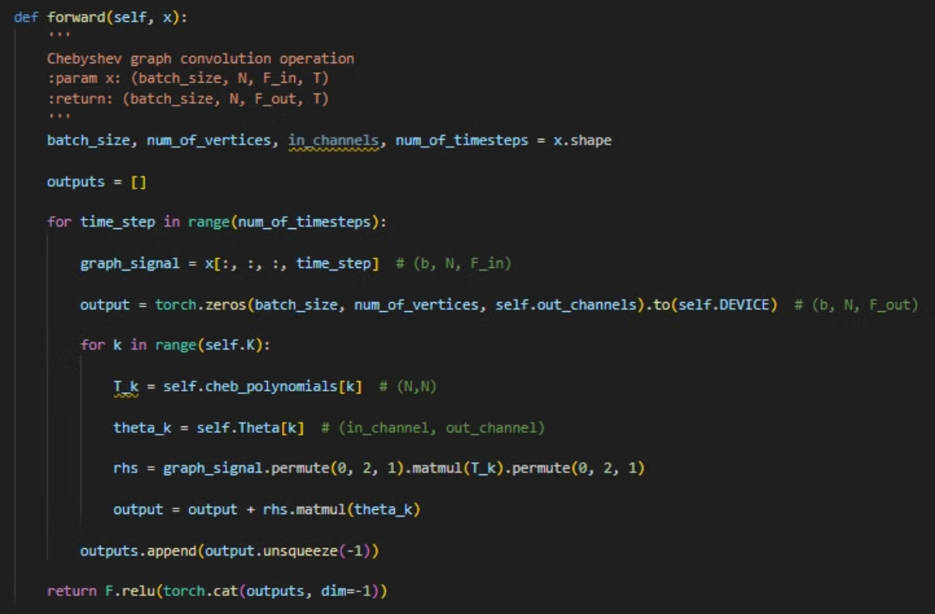
How is the Chebyshev Graph Convolution implemented in code?

Slide 18
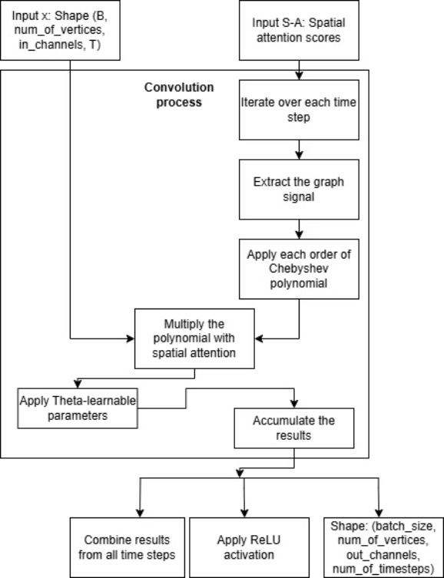
How is the Chebyshev Graph Convolution implemented in diagram?

Slide 19
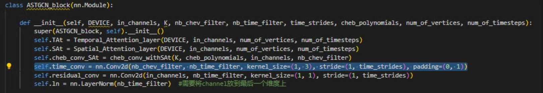
Temporal Convolution
Temporal convolution in ASTGCN captures dependencies along the time axis.
As a standard 1D convolution operation over the time dimension.
In ASTGCN_r.py, this is part of the ASTGCN_block class:
Explanation: This convolution uses a kernel size of 3 in the time dimension, allowing it to capture short-term temporal patterns.

Slide 20

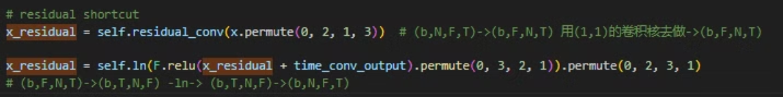
Integration of Spatial and Temporal Convolutions
Chebyshev polynomial computation: The Chebyshev polynomials are pre-computed and passed to the cheb_conv_withSAt class.
Integration to Attention Mechanism: The spatial attention is directly incorporated into the Chebyshev graph convolution (cheb_conv_withSAt class)
Multi-scale temporal convolution: The model uses multiple ASTGCN blocks with different temporal convolution strides to capture patterns at different time scales (ASTGCN_block class)
Residual connections: Being used to facilitate gradient flow and enable training of deeper networks (ASTGCN_block class)

Slide 21
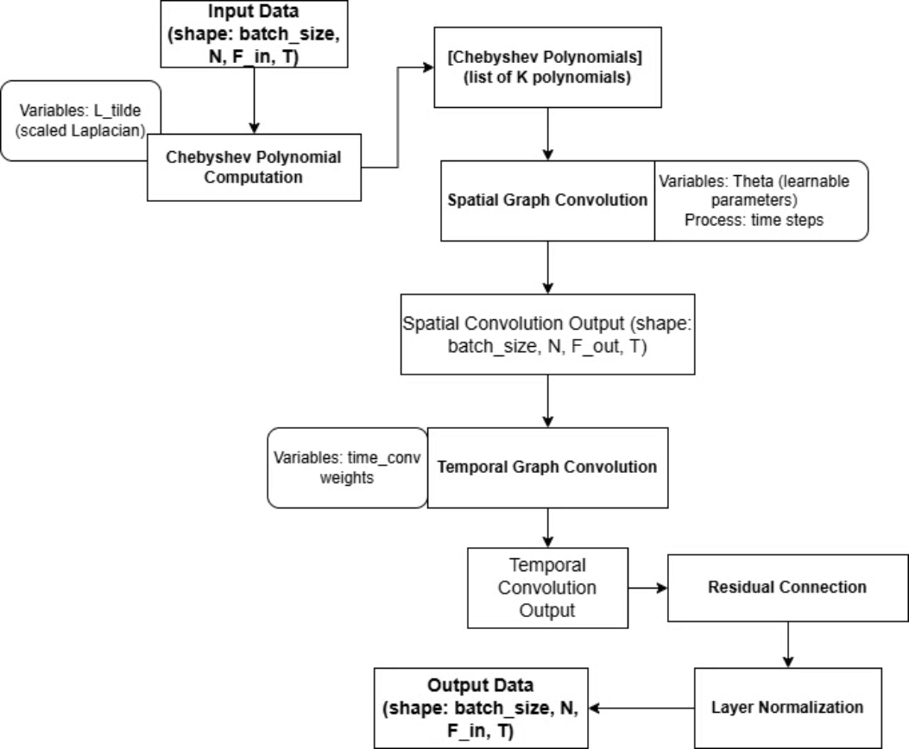
How is the process visualized in diagram?

Slide 22
The relationship between attention mechanism & S-T convolution
Sequential Processing: The attention mechanism is applied before the convolution. The output of the attention mechanism becomes the input for the convolution module ((ASTGCN_block class)
Complementary Roles:
Attention - Helps the model focus on locations and time periods for prediction task.
Convolution: Extracts features from these inputs, capturing local spatial-temporal patterns.
Enhanced Feature Extraction: The attention mechanism guides the convolution to focus on the most important spatial-temporal relationships.
Adaptive Learning: The model adapts to changing traffic patterns by dynamically computing attention weights based on input data.

Slide 23
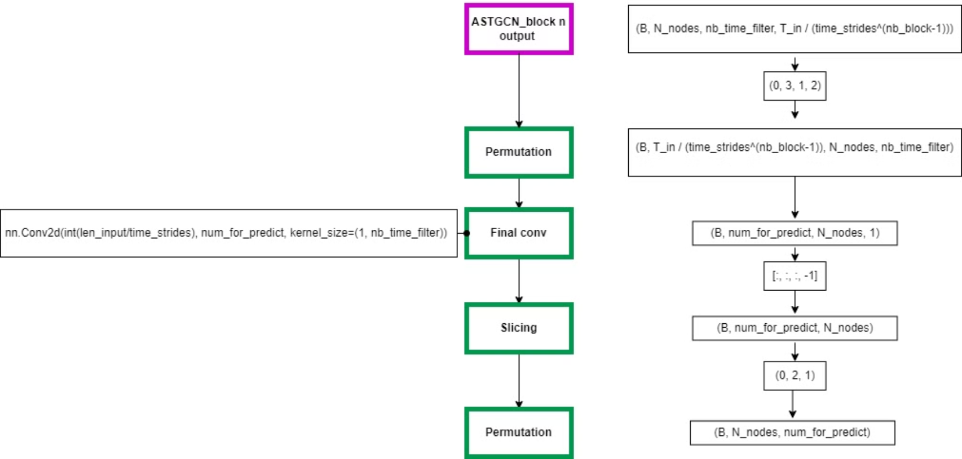
Final Convolution

Slide 24
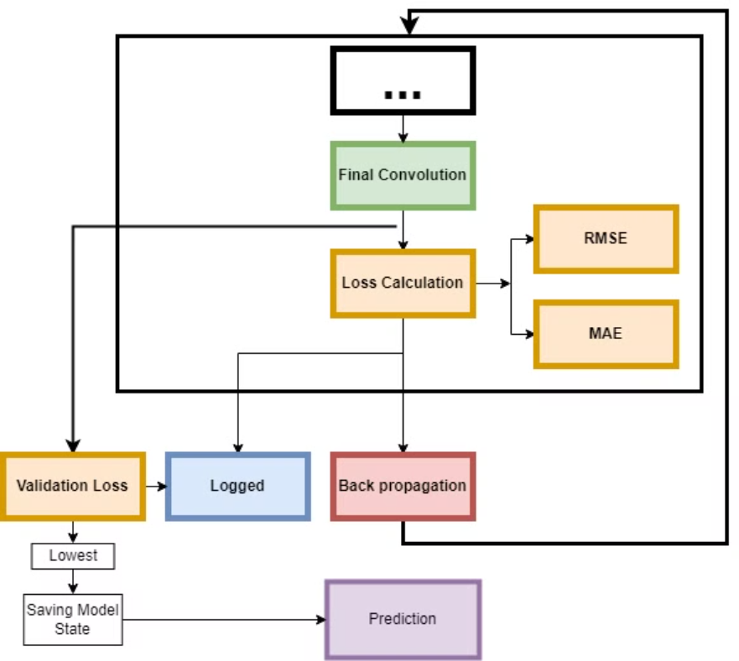
Optimization and Prediction

Slide 25
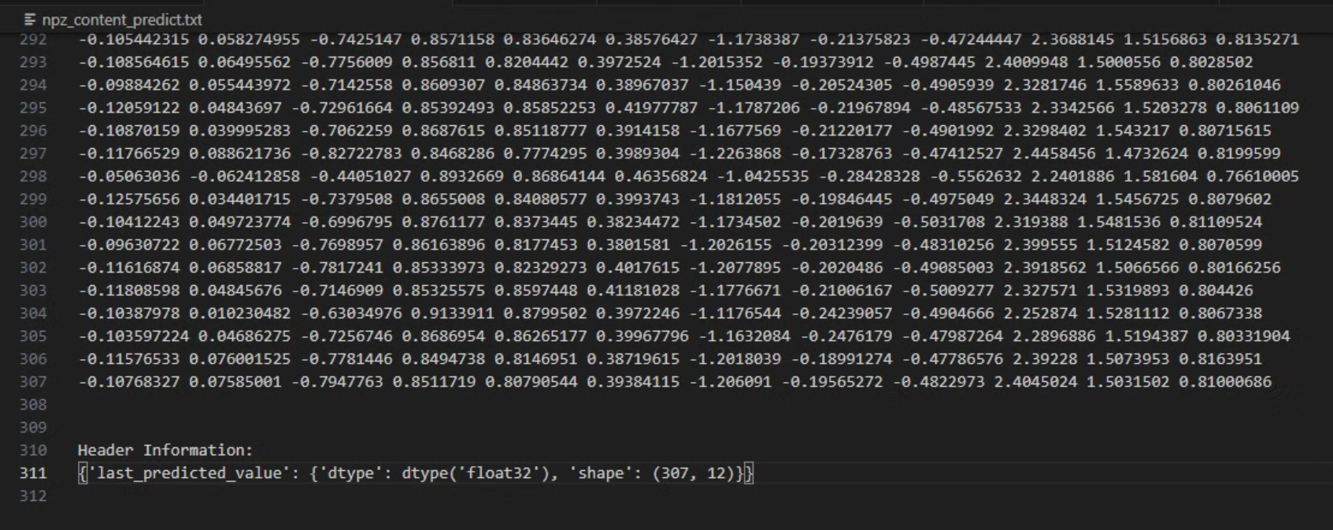
Prediction output

Slide 26
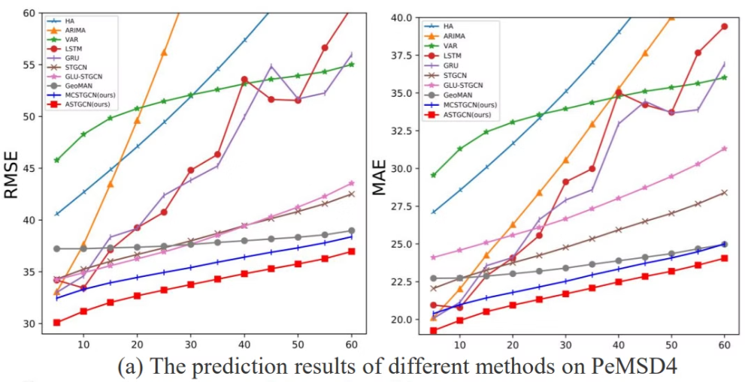
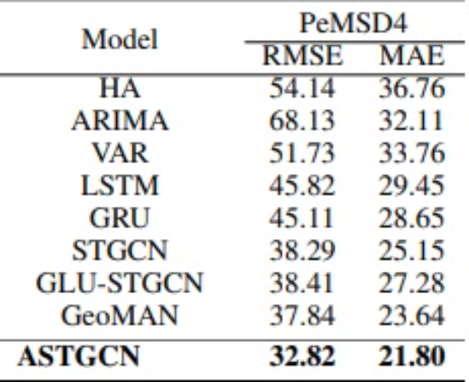
Historical Model Comparison

Slide 27
Recent Model Comparison
FEATURE
ASTGCN (2019)
ASTGNN(2021)
DSTAGNN(2022)
Spatial-Temporal Attention
basic attention mechanism to model spatial and temporal correlations separately within traffic data.
adaptively focus on varying spatial-temporal correlations, providing a more responsive model to sudden changes in traffic conditions.
Hierarchical Multi-Scale Attention that allows the model to adjust its focus at different levels of granularity depending on the context.
Handling of External Influences
Lacks integration of external factors such as weather, events, or road conditions that can significantly influence traffic patterns.
Incorporates external factors like weather conditions into the prediction model
integrating a wide range of external data inputs, such as weather, events, and even socio-economic data, adapting predictions in real-time to these factors.
Graph Neural Network Techniques
basic graph convolutions with limited adaptability to network changes.
Utilizes more advanced graph neural network techniques that improve the model’s ability to learn from complex spatial relationships and interactions within the traffic network.
Enhanced Deep Graph Convolutional Networks that include deeper layers and specialized node processing for complex traffic networks
Modeling of Traffic Patterns
Static modeling of traffic patterns based on historical data without adapting to anomalies or non-periodic events.
consider both periodic trends and non-periodic anomalies, making the system more adaptable to unusual traffic conditions.
Continuous Time Series Analysis that integrates non-linear and non-stationary data processing for predicting highly volatile traffic patterns.
Learning and Adaptation
Operates with a fixed learning model that does not adjust post-deployment, reducing its effectiveness as traffic patterns evolve.
learn continually from incoming data, enhancing its long-term accuracy and adaptability to new traffic trends.
continuously refine and adjust its predictions based on live data, ensuring optimal performance even as traffic dynamics evolve drastically.

Slide 28
Recent Model Comparison
Setting up environment in Anaconda:
Open Anaconda Prompt (Windows) or terminal (Mac/Linux)
Create a new environment: conda create -n <name your created env> python=3.8
Activate the environment: conda activate <name your created env>
Install required packages (for each model requires)
Follow the repository's README for running instructions

Slide 29
Recent Model Comparison
Due to multiple elements that are set up differently in the 2 models that we are going to compare ASTGCN against, minor re-configuration and set-up is required for the fairest comparison in our ability:
Models:
- ASTGCN: The latest version available on GitHub by the authors
- AGTGNN: The latest version available on GitHub by the authors
- DSTAGNN: base version since no newer version posted by authors

Slide 30
Recent Model Comparison
Data splitting:
Using the baseline 6:2:2 ratio on the PemS04 dataset
Config file:
Prediction window: num_for_predict = 12 (1 hour)
Number of terms of the Chebyshev polynomial (equal to the number of spatial attention heads): K = 3
epochs = 30
learning_rate = 0.001
Training file: Adam optimizer

Slide 31
Recent Model Comparison
Devices to run: Lenovo Legion Slim 5 with:
CPU: Intel Core i7-13700H (2.40GHz up to 5.00GHz, 24MB Cache), 14 cores, 20 threads
GPU: NVIDIA GeForce RTX 4060 8GB GDDR6, TGP: 140W
Set-up details:
Following the guide from the corresponding papers for each model
Running with Anaconda environment
Using the follow-up links provided in the respective GitHub repositories for environment setup
Additional notes:
The setup is based on the general concepts from the papers, but the actual code implementation may differ slightly.

Slide 32
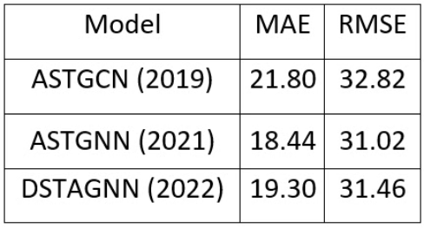
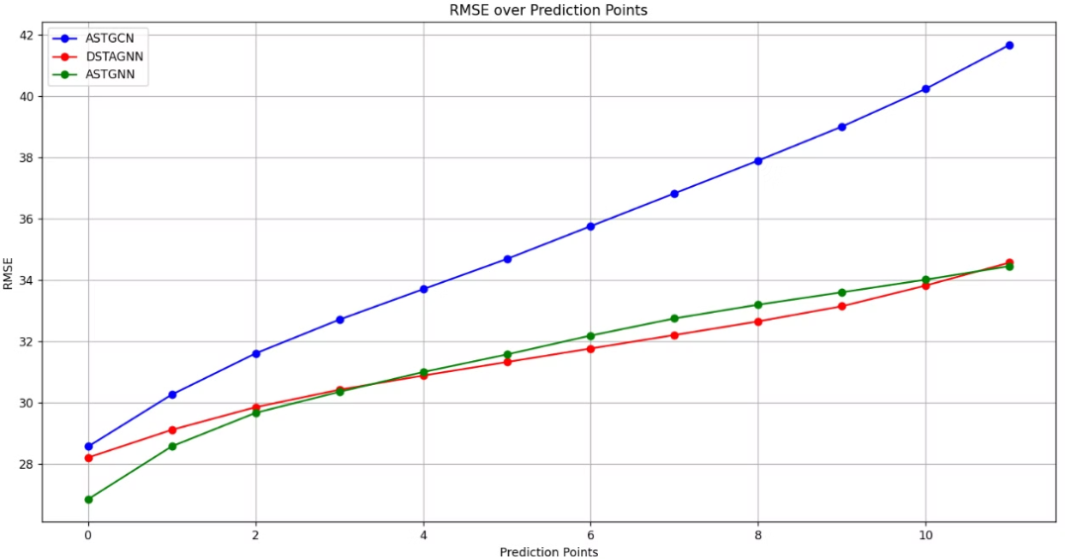
Recent Model Comparison

Slide 33
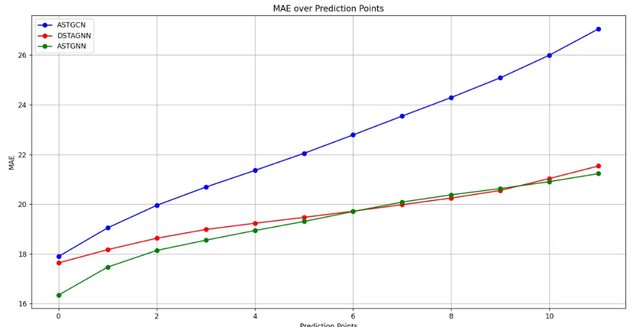
Recent Model Comparison

Slide 34
Thanks for listening

Slide 35
Reference
Bruna, J., Zaremba, W., Szlam, A., & Lecun, Y. (2014). Spectral networks and locally connected networks on graphs. In International Conference on Learning Representations.
Defferrard, M., Bresson, X., & Vandergheynst, P. (2016). Convolutional neural networks on graphs with fast localized spectral filtering. In Advances in Neural Information Processing Systems (pp. 3844-3852).
Guo, S., Lin, Y., Feng, N., Song, C., & Wan, H. (2019). Attention Based Spatial-Temporal Graph Convolutional Networks for Traffic Flow Forecasting. Proceedings of the AAAI Conference on Artificial Intelligence, 33, 922–929. https://doi.org/10.1609/aaai.v33i01.3301922
Hammond, D. K., Vandergheynst, P., & Gribonval, R. (2011). Wavelets on graphs via spectral graph theory. Applied and Computational Harmonic Analysis, 30(2), 129-150.

Slide 36
Reference
Lan, S., Ma, Y., Huang, W., Wang, W., Yang, H. & Li, P.. (2022). DSTAGNN: Dynamic Spatial-Temporal Aware Graph Neural Network for Traffic Flow Forecasting. Proceedings of the 39th International Conference on Machine Learning, in Proceedings of Machine Learning Research 162:11906-11917 Available from https://proceedings.mlr.press/v162/lan22a.html
Liang, Y., Ke, S., Zhang, J., Yi, X., & Zheng, Y. (2018). GeoMAN: Multi-level attention networks for geo-sensory time series prediction. In Proceedings of the 27th International Joint Conference on Artificial Intelligence (pp. 3428-3434).
Li, Y., Yu, R., Shahabi, C., & Liu, Y. (2018). Diffusion convolutional recurrent neural network: Data-driven traffic forecasting. In International Conference on Learning Representations.
S. Guo, Y. Lin, H. Wan, X. Li and G. Cong, "Learning Dynamics and Heterogeneity of Spatial-Temporal Graph Data for Traffic Forecasting," in IEEE Transactions on Knowledge and Data Engineering, vol. 34, no. 11, pp. 5415-5428, 1 Nov. 2022, https://doi.org/10.1109/TKDE.2021.3056502

Slide 37
Reference
Vaswani, A., Shazeer, N., Parmar, N., Uszkoreit, J., Jones, L., Gomez, A. N., ... & Polosukhin, I. (2017). Attention is all you need. In Advances in Neural Information Processing Systems (pp. 5998-6008).
Zhang, J., Zheng, Y., Qi, D., Li, R., & Yi, X. (2018). DNN-based prediction model for spatio-temporal data. In Proceedings of the 26th ACM SIGSPATIAL International Conference on Advances in Geographic Information Systems (pp. 92-101).
Lan, S., Ma, Y., Huang, W., Wang, W., Yang, H., & Li, P. (2022, June). Dstagnn: Dynamic spatial-temporal aware graph neural network for traffic flow forecasting. In International conference on machine learning (pp. 11906-11917). PMLR.
Guo, S., Lin, Y., Wan, H., Li, X., & Cong, G. (2021). Learning dynamics and heterogeneity of spatial-temporal graph data for traffic forecasting. IEEE Transactions on Knowledge and Data Engineering, 34(11), 5415-5428.

